Slide 1
Cardio Good Fitness Case Study
Ian Hanes
UT DSBA PGP - 2021

Slide 2
Background/Objectives
Cardio Good Fitness is a store that sells running equipment, most notably several models of treadmills
We have been asked to develop a customer profile for the different products, analyze the provided dataset, and generate some recommendations to assist in targeting new customers

Slide 3
Data Summary
The data contains the following demographic information:
Variable | Description
Product | Model no. of treadmill
Age | Number of years old per customer
Gender | Male or Female
Education | Number of years of schooling
Marital Status | Single or partnered
Usage | Number of times the customer will use the treadmill each week
Fitness | Fitness self score from 1 - 5
Income | Yearly income of customer
Miles | Expected to run
Observations | Variables
180 | 9

Slide 4
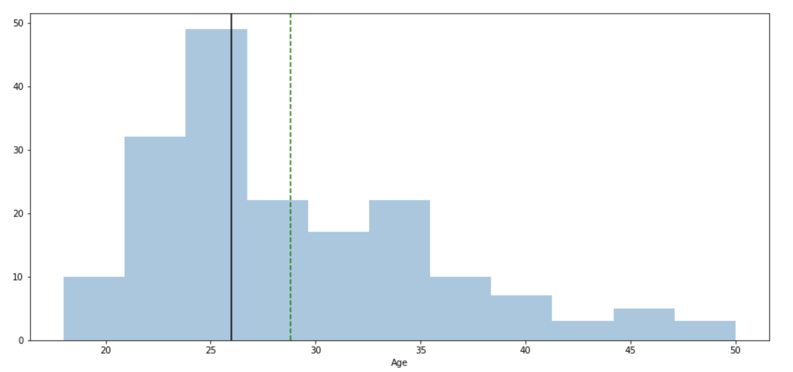
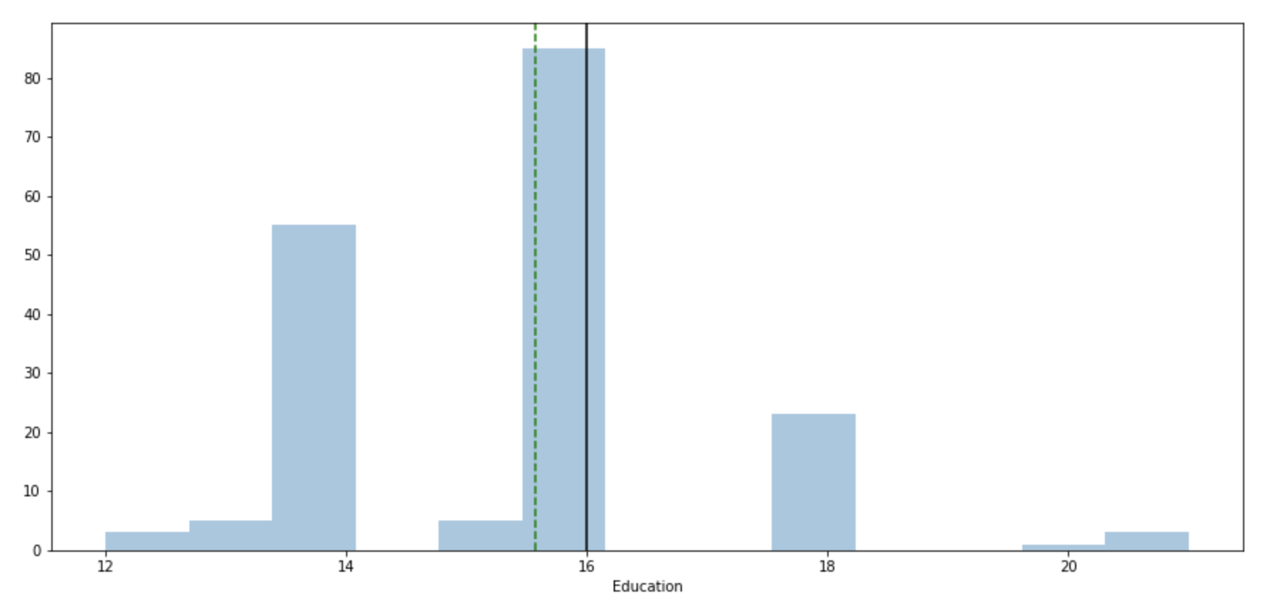
Exploratory Data Analysis – Age/Education
In order to build out a customer profile, let’s examine some basic variables, starting with Age and Education
Observations:
In general, customers are young adults (18-33) with at least some level of college education
Distribution of age is right skewed
Despite a mostly younger clientele, there are users as old as 50
Similarly, there is a non-trivial amount of masters/PhD holders as customers

Slide 5
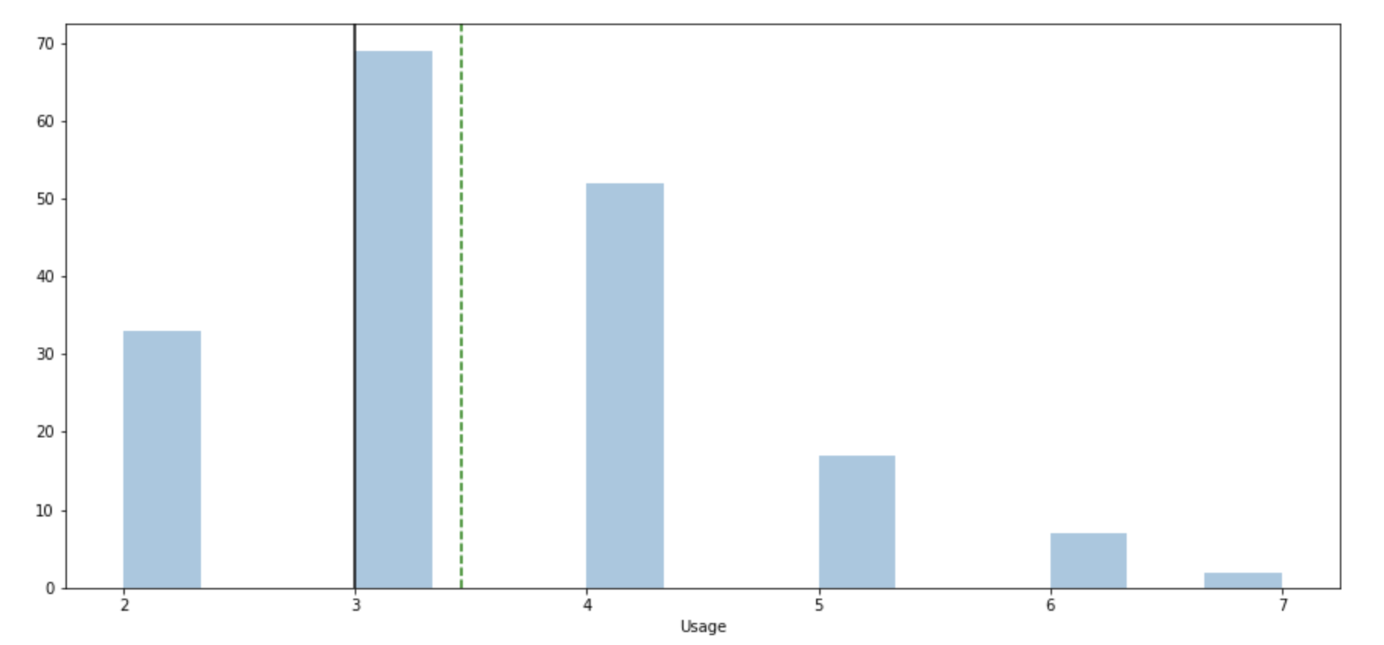
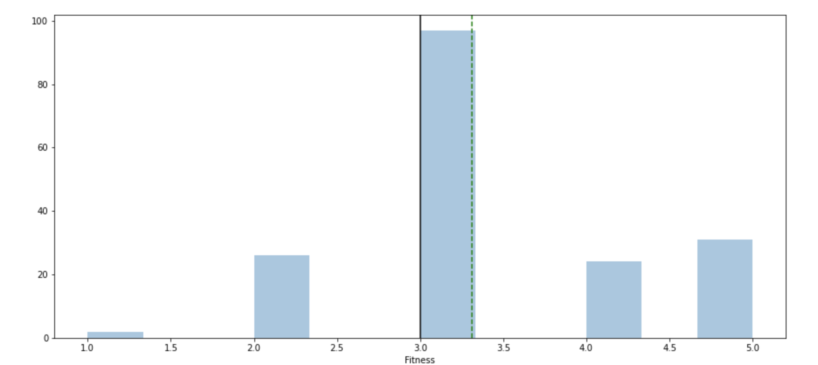
Exploratory Data Analysis – Usage/Fitness
Continuing from the previous slide, let’s now examine usage and fitness levels
Observations:
The vast majority of customers use their treadmills at least 3 times per week
A similar majority rated themselves as 3 or higher on a fitness scale from 1 - 5
The average usage is 3x per week with a median of 3.5
The average fitness level is 3 with a median of about 3.4
Based on this, we can assume that the average customer is also already in good shape and a moderate or above user

Slide 6
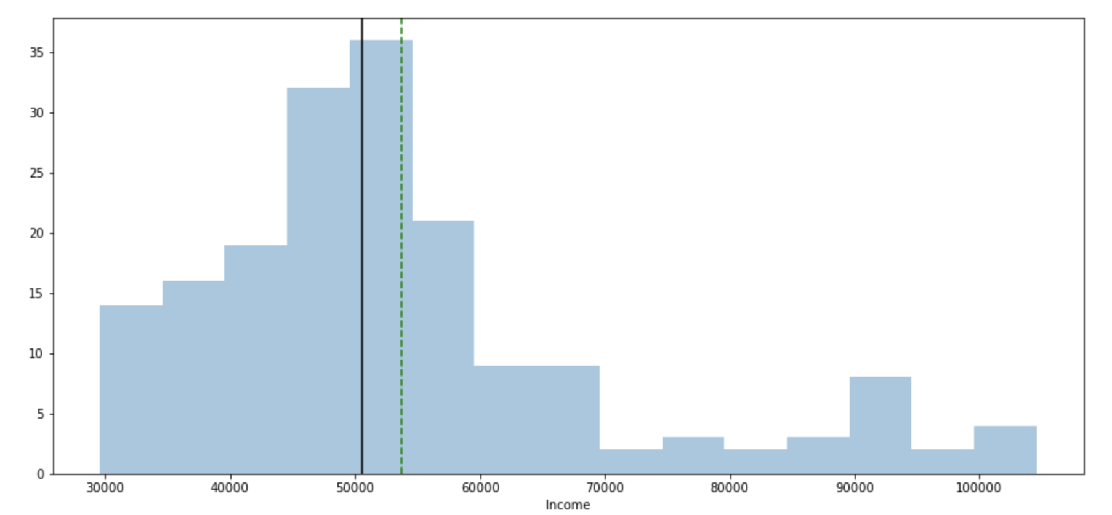
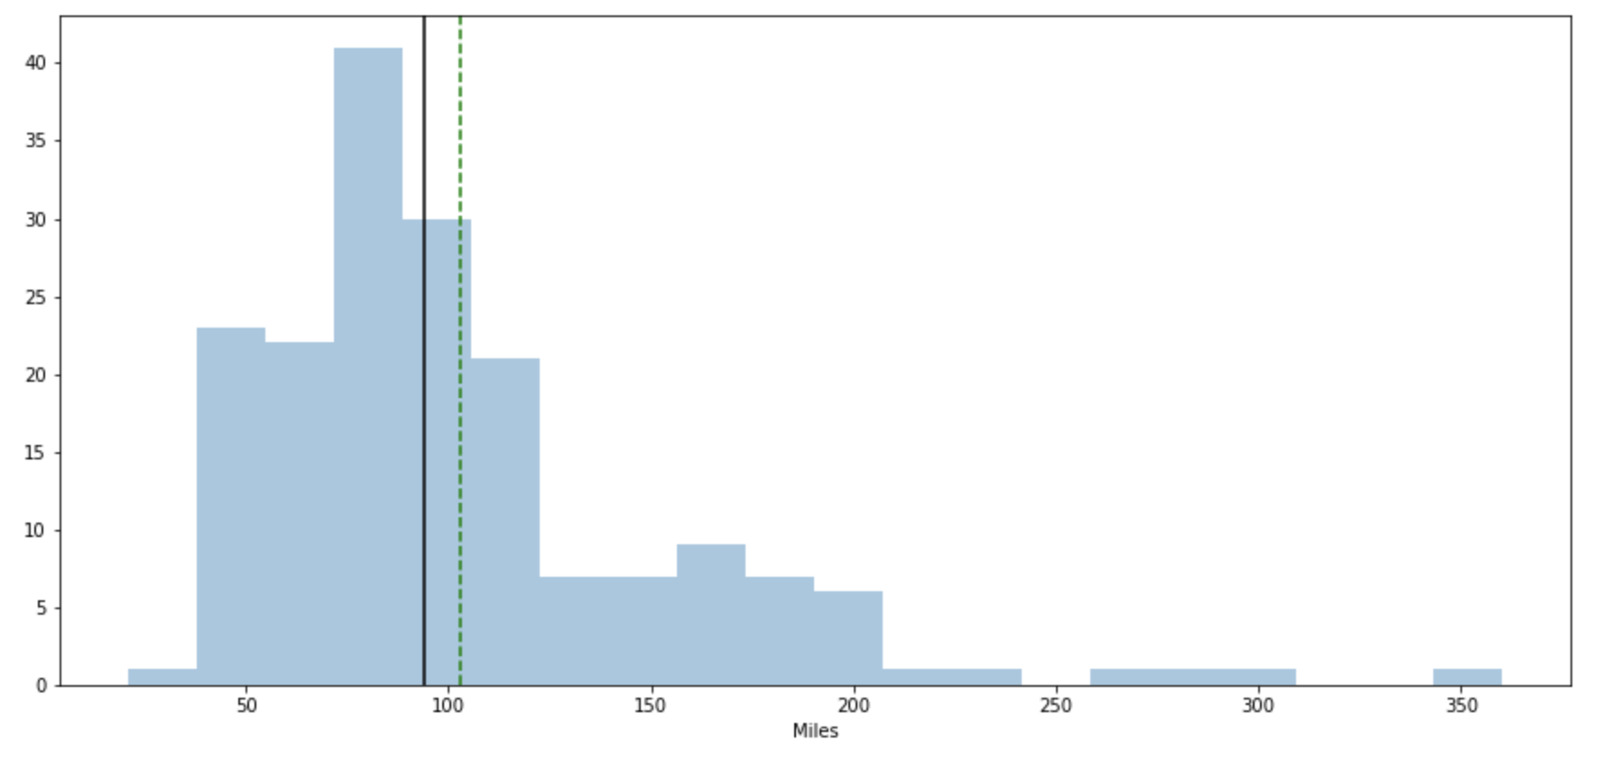
Exploratory Data Analysis – Income/Miles
Continuing from the previous slide, let’s now examine income and miles
Observations:
The median income is about $52,000, but there is a considerable range of incomes
Similarly the median mileage is around 100, but a wide range of mileages exists
This suggests that while the products are most popular with intermediate level runners, there is viability for more advanced athletes
Additionally, there is a baseline interest from higher earners that may not be capitalized on

Slide 7
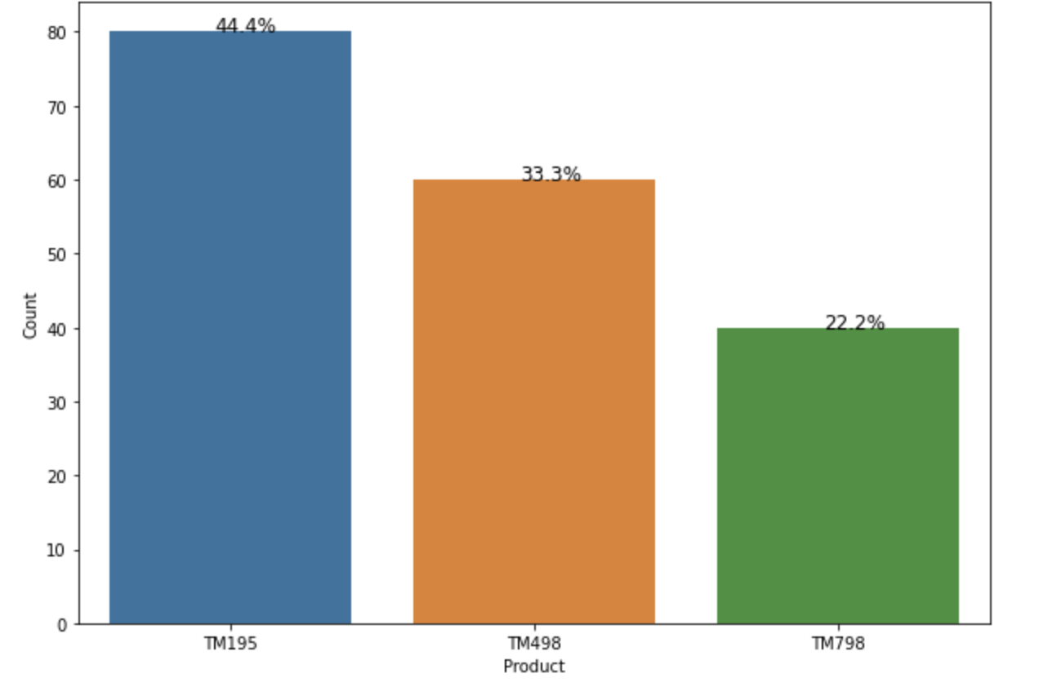
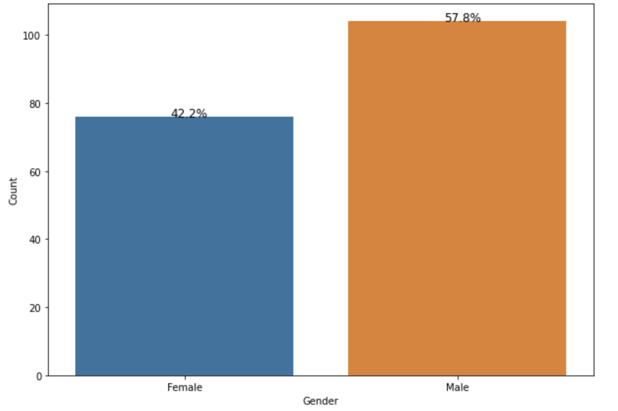
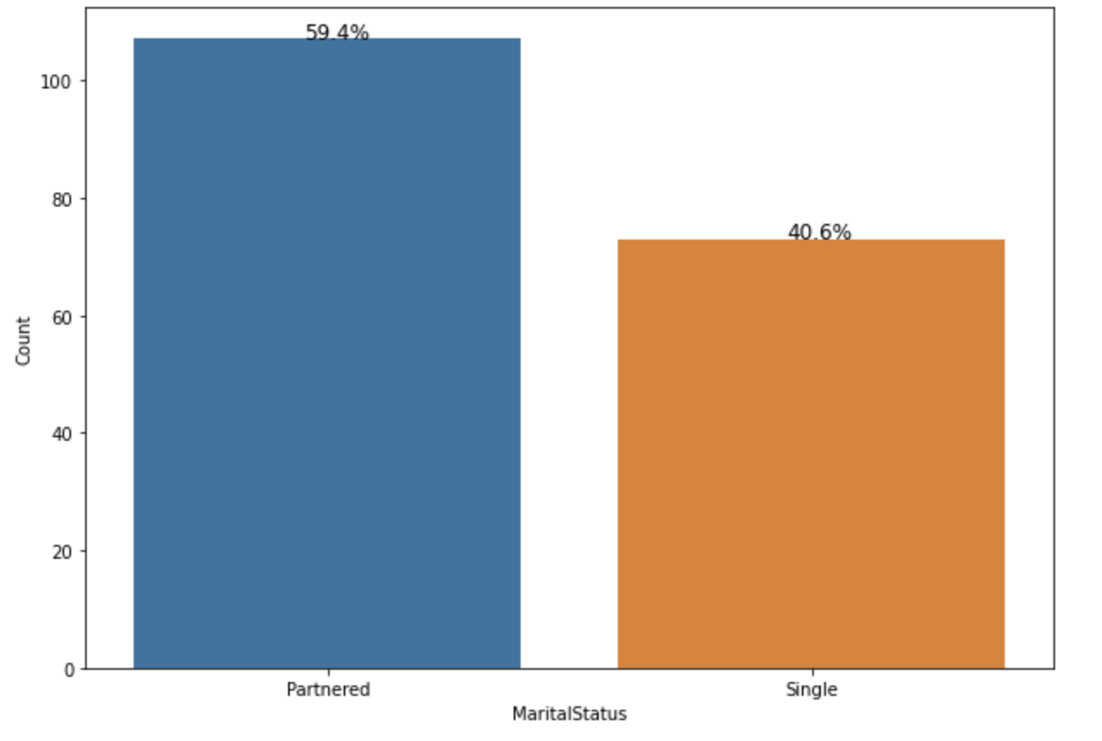
Exploratory Data Analysis – Product/Gender/Marital Status
Continuing from the previous slide, let’s now examine product, gender, and marital status
Observations:
The TM195 is the best seller with the TM489 and TM789 decreasing by 11.1% and 22.2%
A slight majority of customers are men
A slight majority of customers are married

Slide 8
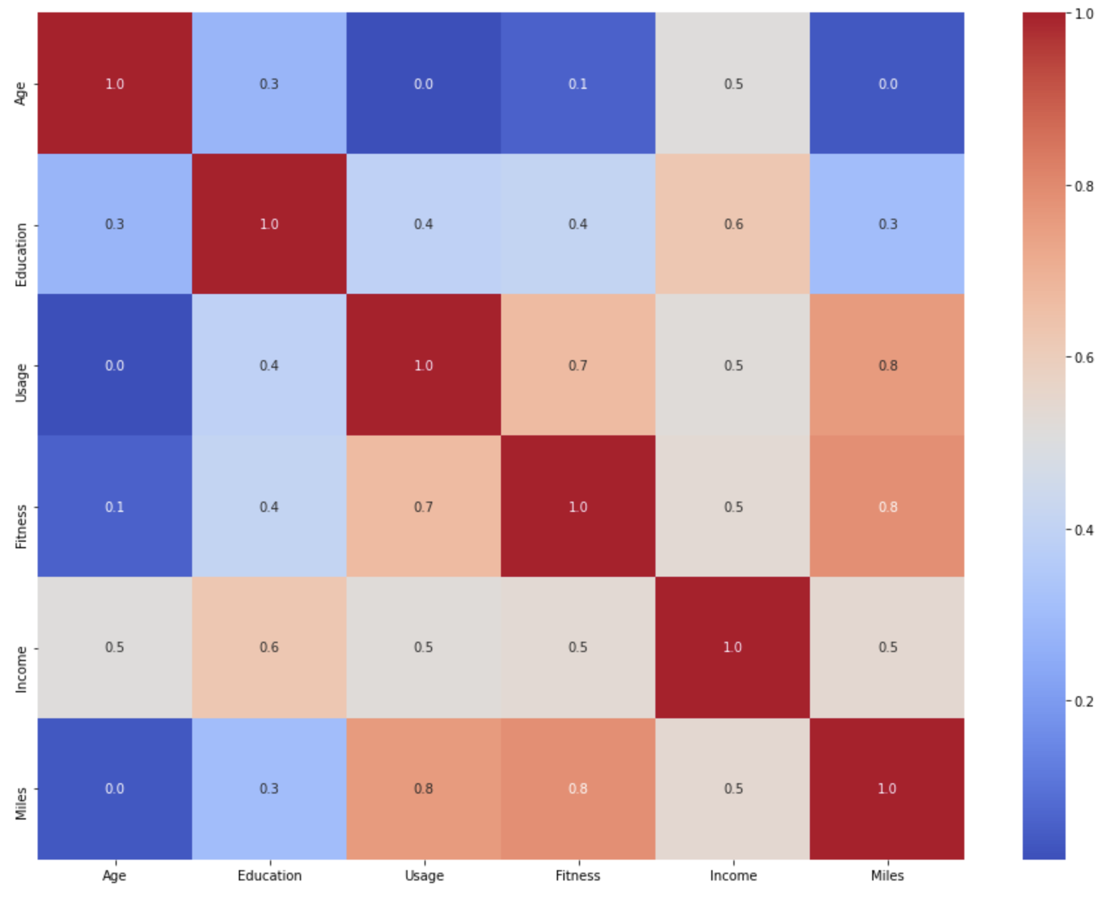
Exploratory Data Analysis – Correlation Matrix
Observations:
Age carries a strong negative correlation with fitness, usage, and miles
Usage, fitness, and miles are strongly correlated with each other, making them the key variables to examine
Income and education are also slightly positively correlated
Beyond these observations, no strong correlations seem to exist
Key Takeaways:
The older a customer gets, the lower their fitness, usage, and mileage rate drops
Most customers are fit, run a lot, and have high usage rates

Slide 9
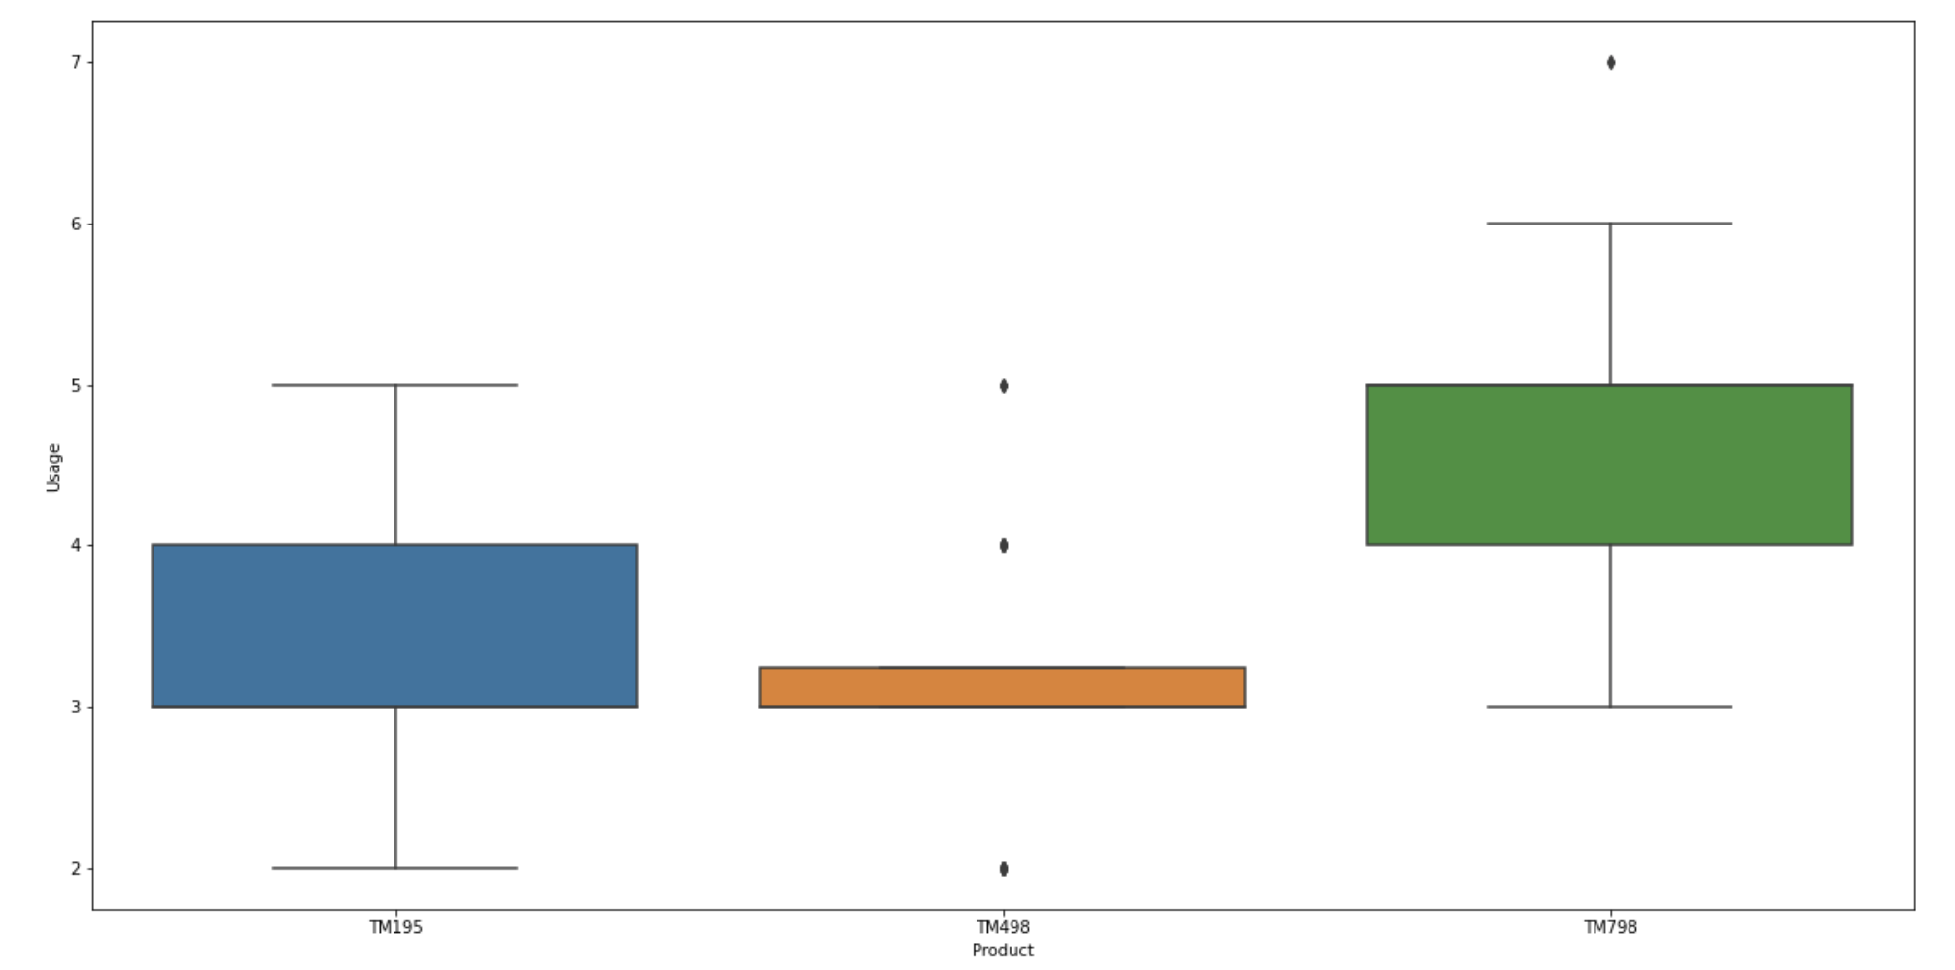
Exploratory Data Analysis – Usage Across Products
Observations:
Despite having the lowest sales, the TM798 is strongly preferred by customers with high usage rates
The TM498 customers have the smallest range of usage rates, suggesting that they are the most casual users

Slide 10
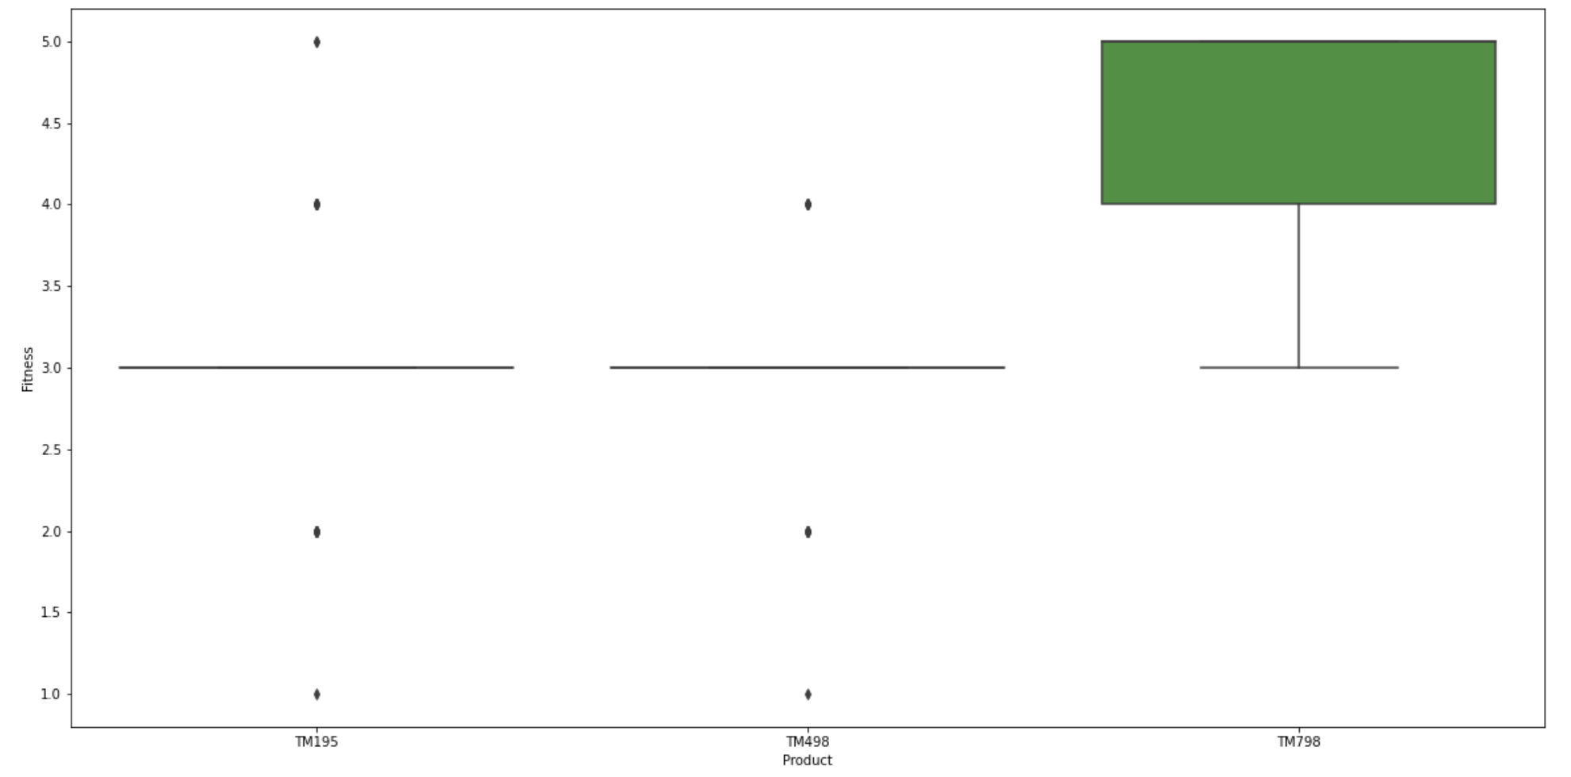
Exploratory Data Analysis – Fitness Across Products
Observations:
Continuing from the previous trend, users of the TM798 are highly fit
In general, users of the other two models are above average fitness, with a few outliers

Slide 11
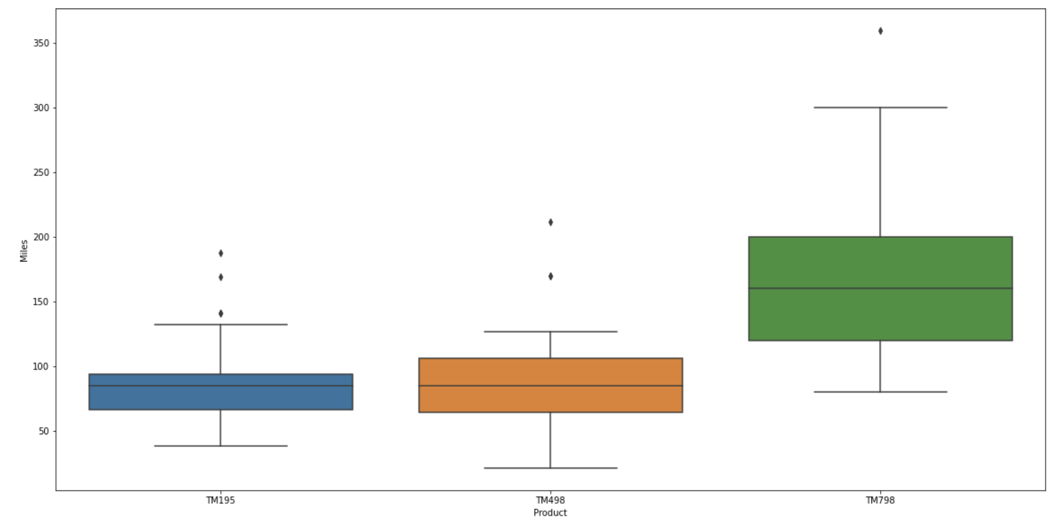
Exploratory Data Analysis – Miles Across Products
Observations:
Following up on the previous trends, the TM798 is extremely popular with high mileage customers
The other two products sell quite well with customers that run more modest mileages

Slide 12
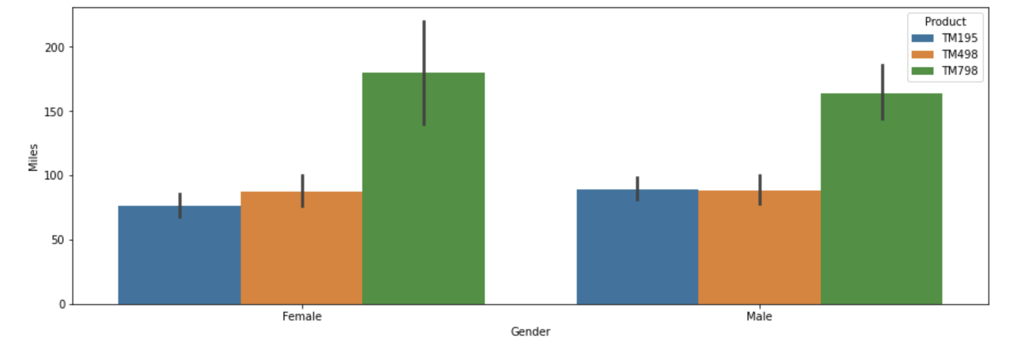
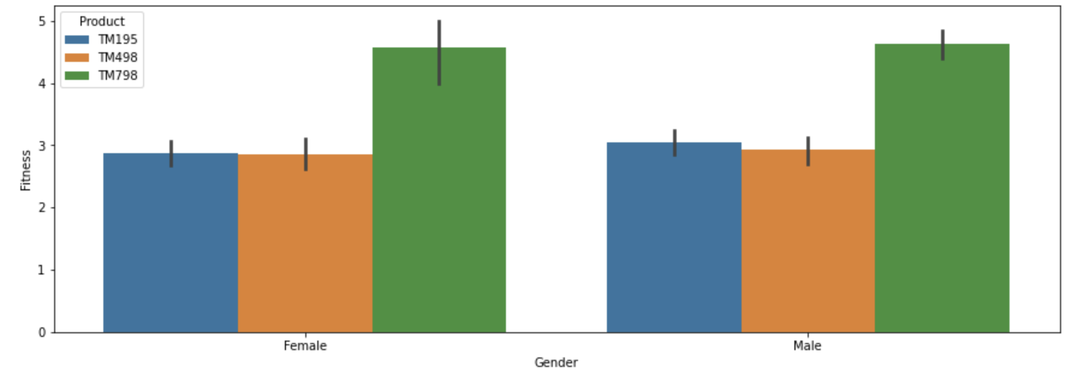
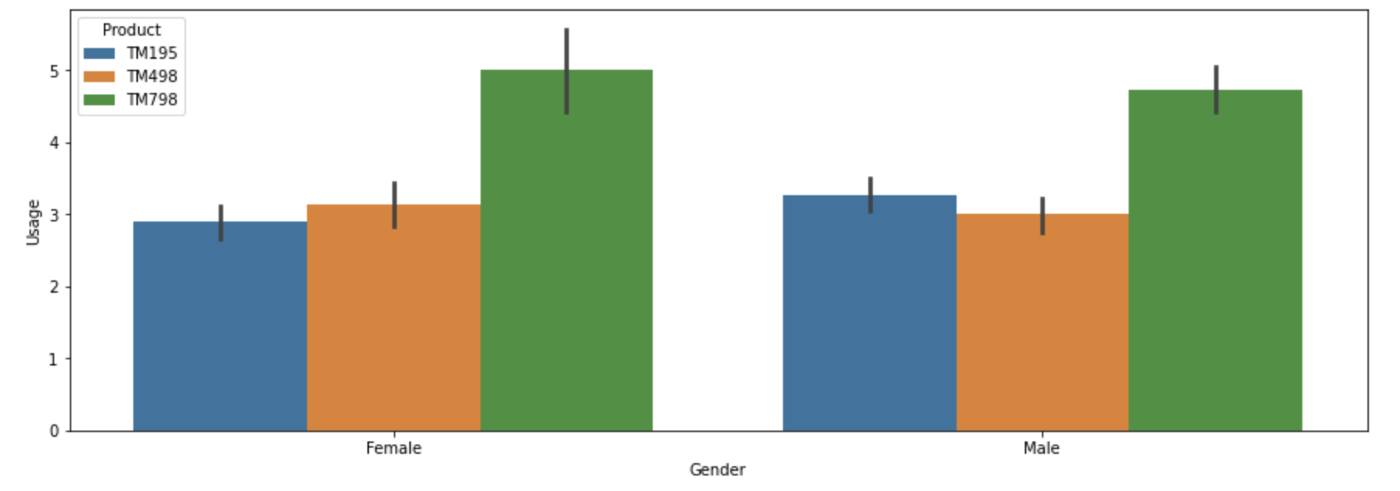
Exploratory Data Analysis – Gender Analysis
Observations:
No obvious trend emerges from gender; male and female stats appear similar
As shown previously, the TM798 is the most popular product for our key variables

Slide 13
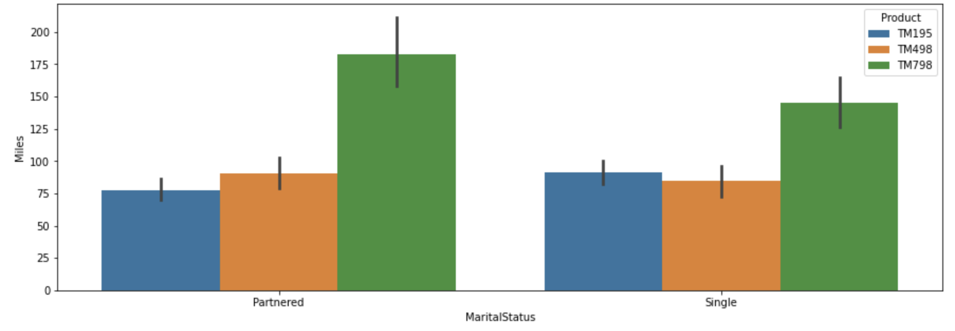
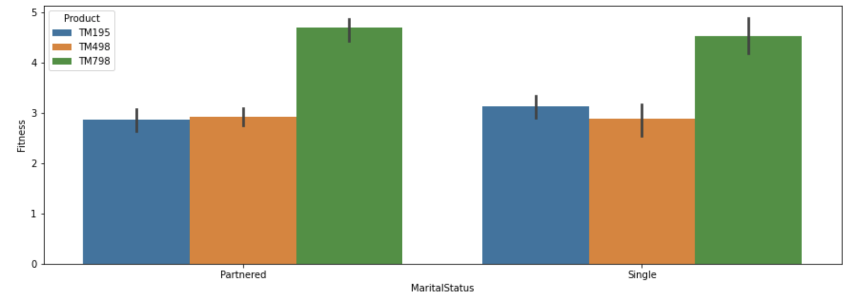
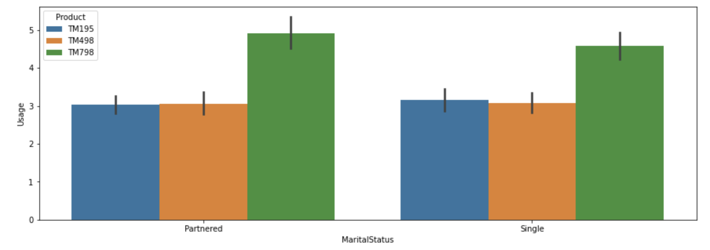
Exploratory Data Analysis – Marital Status Analysis
Observations:
Despite being the lowest selling model, the TM798 is hugely correlated with highly fit customers
Even though the TM498 has lower sales than the TM195, they share the same popular customer profile

Slide 14
Conclusion
Cardio Good Fitness provided data on the demographics of 180 customers who bought one of three treadmills. The data contained information about gender, age, marital status, fitness level/usage, education, and income. After exploratory data analysis the following conclusions were drawn:
1. The average customer is a college educated young adult (18-33) who is already in average shape or better
2. Age had a strong negative correlation with every variable except income
3. Aside from Fitness/Usage/Miles, there were no other strong correlations in the data
4. Despite having the lowest sales, the TM798 correlates very strongly with the most fit customers
5. Although the TM195 has higher sales than the TM498, they share a similar target customer and therefore may be competing against each other

Slide 15
Recommendations
1. The TM798 sells poorly, but is very popular with serious athletes. Stronger marketing efforts for this product could increase sales
2. The vast majority of customers are 33 years old or under. Marketing a product that is more suitable for older users could help capture a larger market.
3. The TM195 and TM498 seem to share very strong correlations with key variables (fitness/usage/miles). With the TM195 outperforming the sales of the TM498, it may be worth rebranding one to distinguish it to a different demographic (perhaps to an older clientele?)
4. The median income of customers was $50,596 per year. There were also no strong correlations with income, suggesting that these products are widely popular. It could be beneficial to market either a premium treadmill to higher earners, or a budget treadmill to low earners (or perhaps both!)
5. Procure pricing data of each model of treadmill to build a model to predict optimal pricing
6. The majority of customers are already in good shape, consider stronger marketing efforts to customers who are looking to get in shape

